Slide 1
Week 2 Project
Yo, it’s me, Lumpkinn, back for week 2.
This week, I’m planning on making something unique, and deviating from the tutorial.

Slide 2
I’ll be making….
An Arcade Stick!
I mainly just wanted to focus on the housing for this week, so I could eventually make the internals as my own personal project!

Slide 3
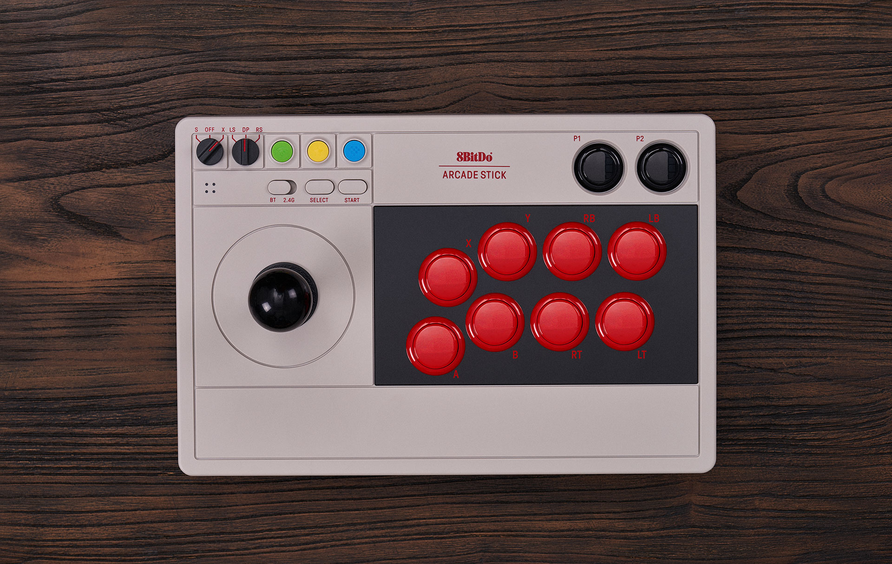
My inspiration
I’m planning on making an 8-button stick, and I’ll be doing the majority of it in blender, and editing the rest in a CAD software. (Mostly because I’m more famillar with blender.)
This is something similar to what I’m
planning to make!

Slide 4
See you for now!
Good luck with your projects everyone, and stay tuned if you’re interested in seeing the final result!

